Slide 1
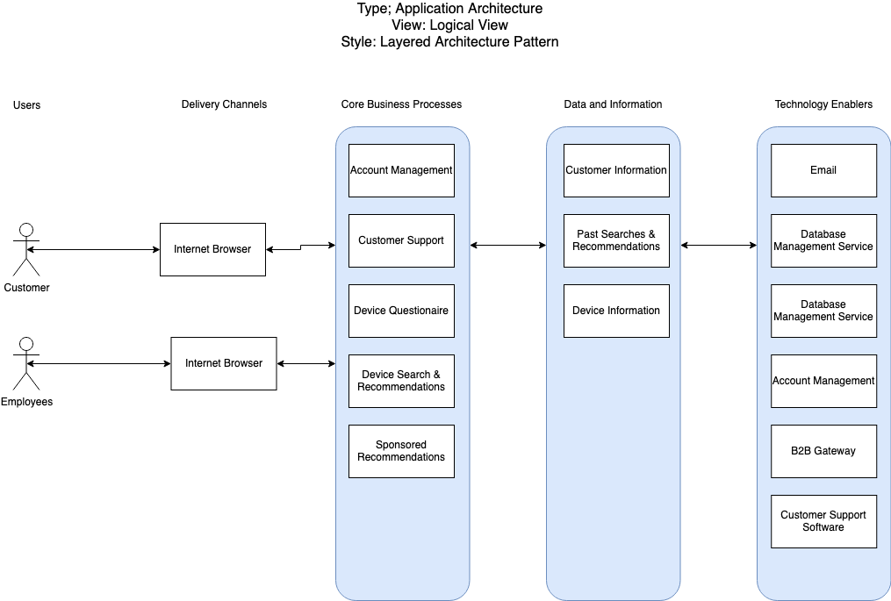
Tech Selector Architecture Diagram

Slide 2
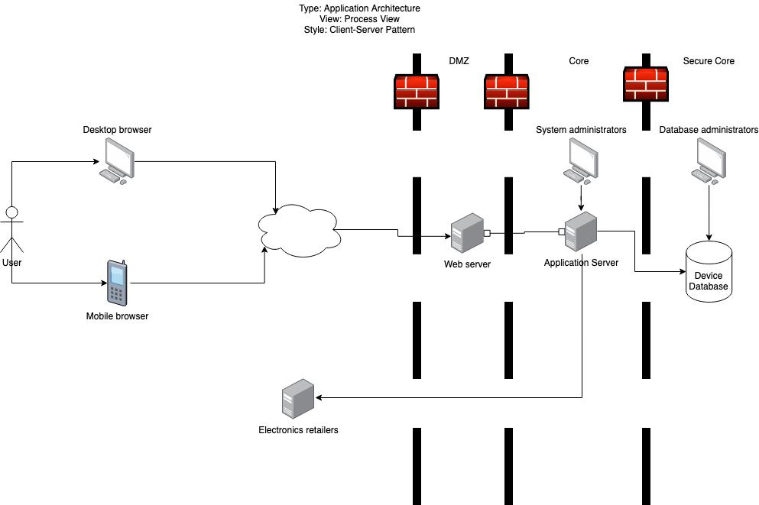
Tech Selector Architecture Diagram

